Slide 1

A Project Report On
“Crime Reporting System”
Submited To
Rao Bahadur Narayanrao Borawake College(Autonomous)
For Partial fulfilment of TY-B.sc(computer science)
Submited By
Kangare Aditya Kerubhau Kothe Prem Shivaji Guided By Prof.Dr.Shinde B.S.
In The Academic Year2025-2026

Slide 2


“Education through self help is our moto”– Bhaurao Patil
Rayat Shikshan Sanstha’s R.B.Narayanrao Borawake College Shrirampur,Dist.Ahilyanagar 413709 (Autonomous)
CERTIFICATE
DEPARTMENT OF COMPUTER SCIENCE
This is to certify that Mr.Aditya Kangare & Mr.Prem Kothe has satisfactorily carried out required project work according to the syllabus of Rao Bahadur Narayanrao Borawake college(Autonoumous) Shrirampur during the class TY UG in the Academic Year 2025-2026.
Head Of Dept
Project Guide
Internal Examinar
External Examinar

Slide 3
INDEX
Sr.No. | CONTENT
1 | Acknowledgement
2 | Introduction To System
3 | Scope of The System
4 | Existing System
5 | Fact Finding Technique
6 | Identification Of Data
7 | Requirements Specification
8 | Feasibility Study
9 | Normalization
10 | UML Diagram
11 | Data Dictionary
12 | Reports
13 | Conclusion
14 | Biliography

Slide 4
ACKNOWLEDGEMENT
The Project Title Crime Reporting system would not have been completed without the valuable guidance and encouragement of Prof.Dr.Shinde Sir.
We are also extremely thanks to Dr.B.S.Shinde sir Department of computer science & all staff members for their guidance and moral support.
We are also thankful to all those who were extremely helpful directly or indirectly in completing this project work.
And last but not least, we would like to thank all our friends for their support and timely help.
Thank you…!
Your sincerely, Mr.Aditya Kangare Mr.Kothe Prem

Slide 5
INTRODUCTION
The Crime Reporting System is designed to provide a secure and efficient platform for citizens to report crimes online and for authorities to manage, track, and act on those reports. This documentation outlines the complete structure, functionality, and design of the Crime Reporting System.

Slide 6
SCOPE OF SYSTEM
The Crime Reporting System enables users to file crime complaints online, view case status, and communicate with authorities. For administrators and police officials, the system provides tools to verify reports, update case progress, generate reports, and maintain secure crime databases.

Slide 7
NEED OF SYSTEM
Traditional crime reporting is often time consuming, inconvenient, and prone to delays. Victims may hesitate to visit police stations due to fear, distance, or privacy concerns. The Crime Reporting System addresses these issues by offering a digital platform that ensures quick reporting, data accuracy, user privacy, and round the clock accessibility.

Slide 8
EXISTING SYSTEM
The manual crime reporting process depends heavily on physical paperwork and face to face communication. Issues include long queues, slow documentation, loss of reports, lack of transparency, and difficulty tracking case progress. Citizens often remain uninformed about the status of their complaints.

Slide 9
PROPOSED SYSTEM
The proposed Crime Reporting System provides a centralized digital platform where users can securely submit crime reports, attach evidence, and receive updates. Authorities can efficiently manage complaints, verify information, update investigation status, and generate analytical reports. The system enhances transparency, speeds up investigation processes, and ensures proper documentation.

Slide 10
SYSTEM ANALYSIS
1. Feasibility Study
Feasibility analysis includes:
Technical Feasibility: Ensures required hardware/software exists. Operational Feasibility: Checks user acceptability and usage practicality. Economic Feasibility: Evaluates cost-effectiveness and budget requirements. Time Feasibility: Assesses project completion timeline.
2. Hardware & Software Requirements
Hardware:
Processor: Intel i3 or above RAM: 4GB minimum Storage: Minimum 256GB
Input Devices: Keyboard, Mouse

Slide 11
Software:
Operating System: Windows/Linux
Programming Language: Java / Python / Web Technologies Database: MySQL / Oracle / PostgreSQL
IDE: VS Code / Eclipse / Intel i7
3. Fact Finding Techniques
Interviews: Gathering data from stakeholders.
Questionnaires: Collecting structured feedback. Observation: Monitoring current workflows.
Document Review: Analyzing existing documents and reports. 4. Data Dictionary
Defines all data elements used in the system, including field names, data types, formats, and descriptions.
---

Slide 12
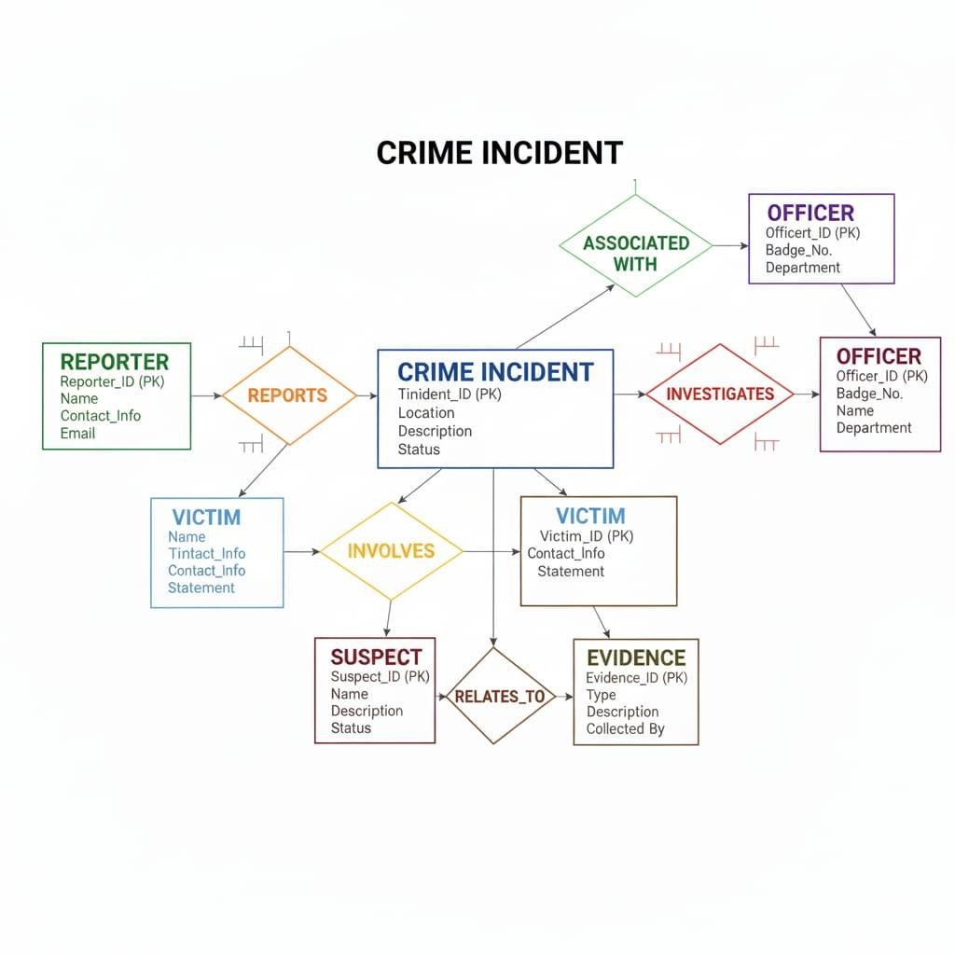
ER Diagram

Slide 13
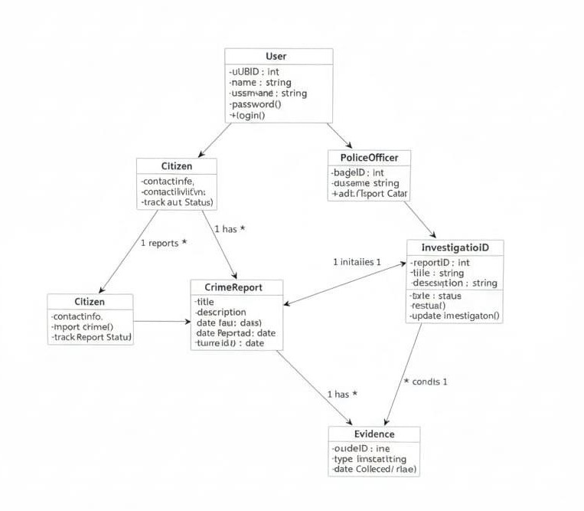
UML Diagram
1. Class Diagram

Slide 14
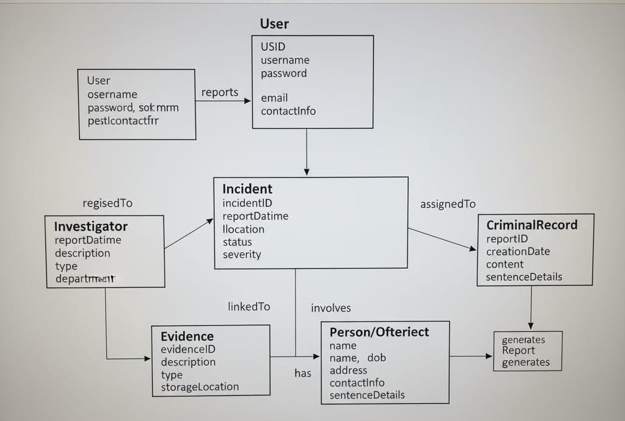
2.Object Diagram

Slide 15
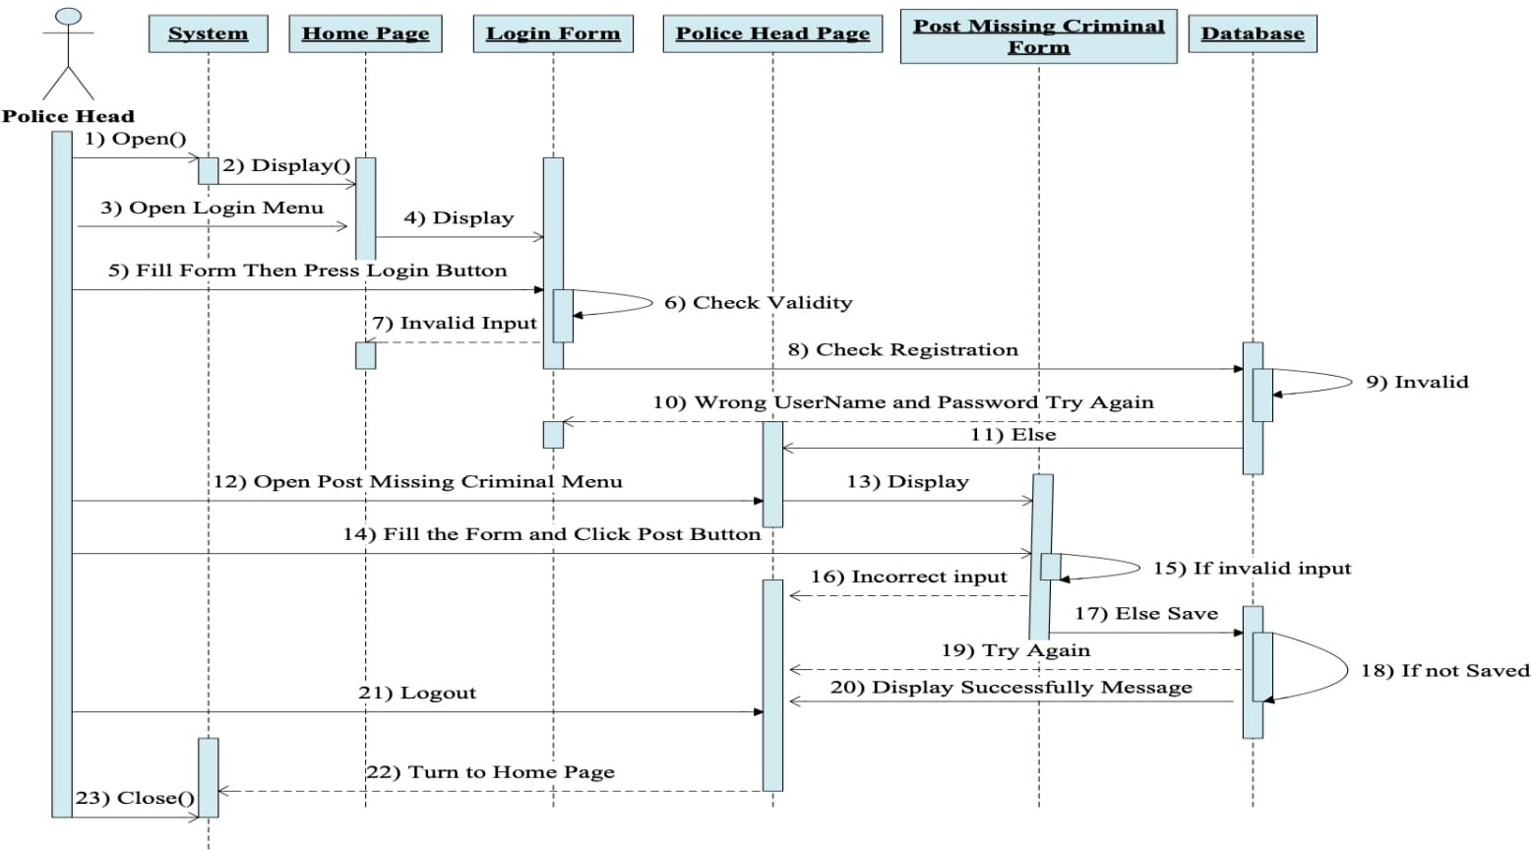
3.Sequence Diagram

Slide 16
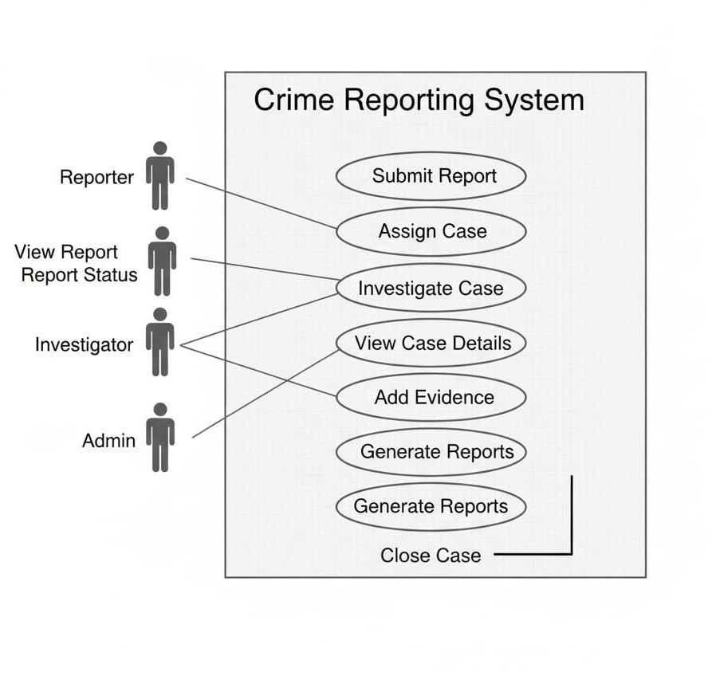
4.Use Case Diagram

Slide 17
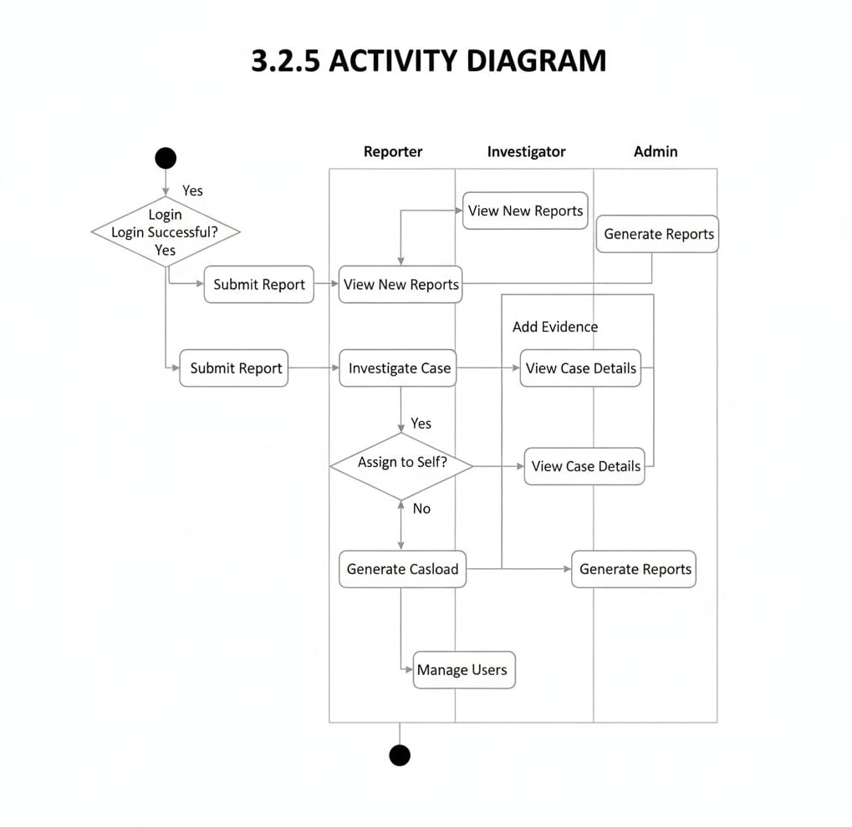
5.Activity Diagram

Slide 18
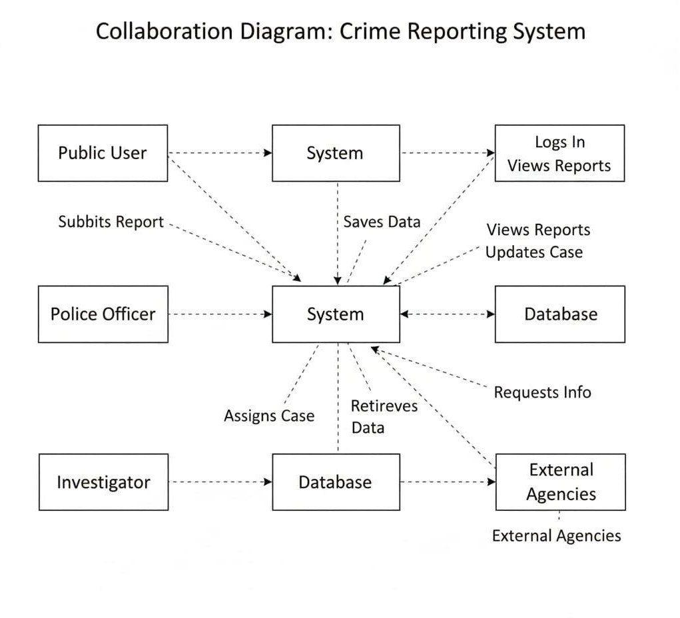
6.Collabration Diagram

Slide 19
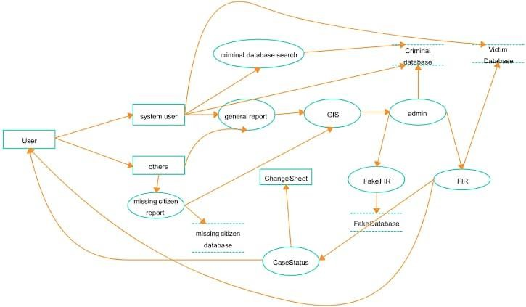
7.Component Diagram

Slide 20
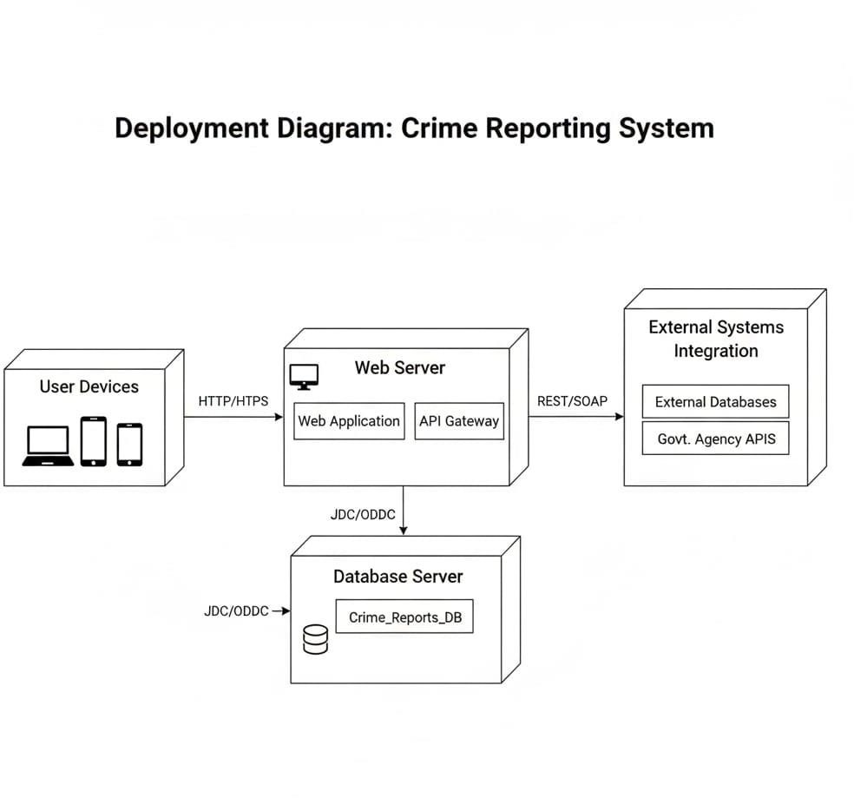
8.Deployment Diagram

Slide 21
Data Dictionary
1. Table: USERS
 | Field Name | Data Type | Size | Constraints | Description
 | user_id | INT | — | PK, Auto Increment | Unique identifier for each user.
 | username | VARCHAR | 50 | Unique, Not Null | Login username.
 | password_hash | VARCHAR | 255 | Not Null | Encrypted password.
 | role | ENUM('Citizen' ,'Officer','Admin') | — | Not Null | User authorization level.
 | full_name | VARCHAR | 100 | Not Null | Full name of the user.
 | email | VARCHAR | 100 | Unique | User email for communication.
 | phone | VARCHAR | 20 | — | Contact phone number.
 | address | TEXT | — | Optional address of user.
 | created_at | DATETIME | — | Default CURRENT_TIMESTAMP | When the account was registered.

Slide 22
2. Table: CRIMES
Field Name | Data Type | Siz e | Constraints | Description
crime_id | INT | — | PK, Auto Increment | Unique crime identifier.
reporting_user_id | INT | — | FK → USERS(user_id) | User who reported the crime.
assigned_officer_i d | INT | — | FK → USERS(user_id), Nullable | Officer assigned to case.
crime_type_id | INT | — | FK → CRIME_TYPES(type_id ) | Type/categor y of crime.
title | VARCHAR | 150 | Not Null | Short summary of the crime.
description | TEXT | — | Not Null | Detailed description of incident.
location | VARCHAR | 255 | Not Null | Where the crime occurred.
status | ENUM('Reported','Under Investigation','Resolved','Closed' ) | — | Default 'Reported' | Current case status.
report_date | DATETIME | — | Default CURRENT_TIMESTAM P | When crime was reported.
incident_date | DATETIME | — | Nullable | When crime actually occurred.
evidence | TEXT | — | Nullable | Notes about evidence submitted.

Slide 23
3. Table: CRIME_TYPES
 | Field Name | Data Type | Size | Constraints | Description
 | type_id | INT | — | PK, Auto Increment | Unique type identifier.
 | type_name | VARCHAR | 100 | Unique, Not Null | e.g., Theft, Robbery, Assault.
 | description | TEXT | — | Nullable | Explanation or notes about type.
4. Table: SUSPECTS
Field Name | Data Type | Size | Constraints | Description
suspect_id | INT | — | PK, Auto Increment | Unique suspect ID.
crime_id | INT | — | FK → CRIMES(crime_id) | Crime linked to suspect.
full_name | VARCHAR | 100 | Not Null | Name of suspect.
age | INT | — | Nullable | Age estimate.
gender | VARCHAR(10) | 10 | Nullable | Gender.
description | TEXT | — | Nullable | Physical description or notes.
status | ENUM('Wanted','Arrested','Cleared') | — | Default 'Wanted' | Suspect case status.

Slide 24
5. Table: VICTIMS
Field Name | Data Type | Size | Constraints | Description
victim_id | INT | — | PK, Auto Increment | Unique victim ID.
crime_id | INT | — | FK → CRIMES(crime_id) | Crime associated with victim.
full_name | VARCHAR | 100 | Not Null | Victim’s name.
age | INT | — | Nullable | Age of victim.
gender | VARCHAR(10) | — | Nullable | Gender.
contact_info | VARCHAR | 100 | Nullable | Optional contact details.
statement | TEXT | — | Nullable | Victim statement.
6. Table: EVIDENCE
Field Name | Data Type | Size | Constraints | Description
evidence_id | INT | — | PK, Auto Increment | Unique evidence ID.
crime_id | INT | — | FK → CRIMES(crime_id) | Which crime this evidence belongs to.
evidence_type | VARCHAR | 100 | Not Null | e.g., photo, video, document, object.
file_path | VARCHAR | 255 | Nullable | Storage location of digital evidence.
description | TEXT | — | Nullable | Details about the evidence.
uploaded_at | DATETIME | — | Default CURRENT_TIMESTAMP | Timestamp of upload.

Slide 25
7. Table: CASE_UPDATES
Field Name | Data Type | Size | Constraints | Description
update_id | INT | — | PK, Auto Increment | Unique update ID.
crime_id | INT | — | FK → CRIMES(crime_id) | Case associated with update.
officer_id | INT | — | FK → USERS(user_id) | Officer who added update.
update_text | TEXT | — | Not Null | Description of progress.
update_date | DATETIME | — | Default CURRENT_TIMESTAMP | When update was posted.
8. Table: FIR_RECORDS (optional)
Field Name | Data Type | Size | Constraints | Description
fir_id | INT | — | PK, Auto Increment | FIR ID.
crime_id | INT | — | FK → CRIMES(crime_id) | Crime related to FIR.
fir_number | VARCHAR | 50 | Unique, Not Null | Official FIR number.
filing_date | DATETIME | — | Not Null | FIR filing date.
officer_in_charge | INT | — | FK → USERS(user_id) | Officer in charge of FIR.
remarks | TEXT | — | Nullable | Notes.

Slide 26
Advantages and Disadvantages
Advantages:
Improved speed and accuracy Automated processes
User-friendly operations High scalability and security
DISADVANTAGES:
Initial development cost Training required for new users
System dependency on technology
---

Slide 27
Future Enhancement
Integration with mobile applications
AI-based analytics and reporting Cloud storage and real-time data sync Multi-language support

Slide 28
Conclusion
The system provides a robust solution to overcome the limitations of the existing process. With enhanced features, scalability, and user-friendly design, it delivers significant improvements in performance and reliability.

Slide 29
Biliography
Software Engineering – Roger S. Pressman
UML Distilled – Martin Fowler Online technical documentation Research papers and project reports

